Slide 1




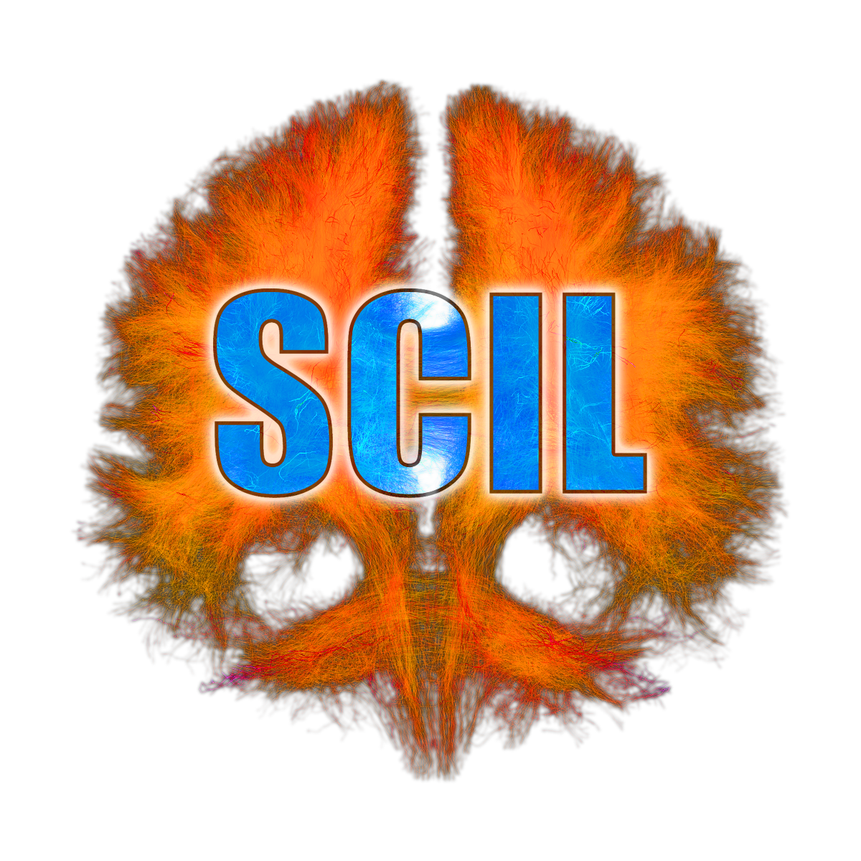
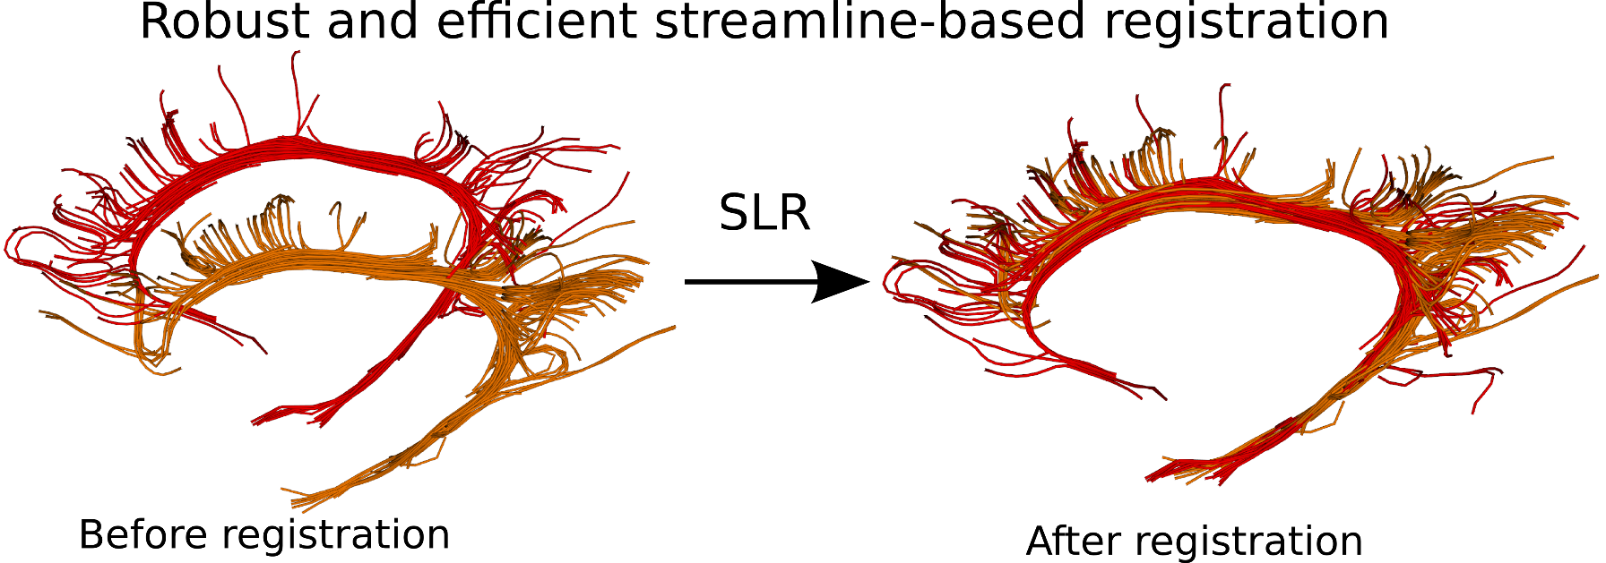
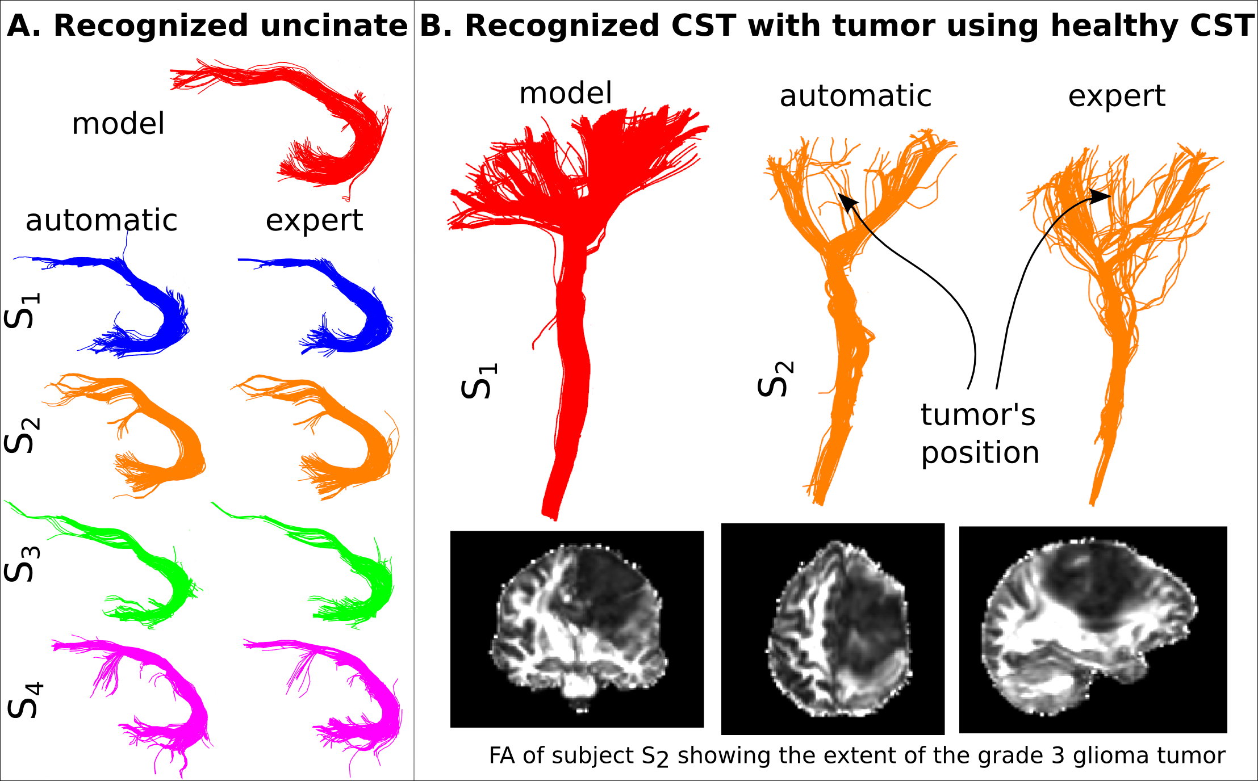
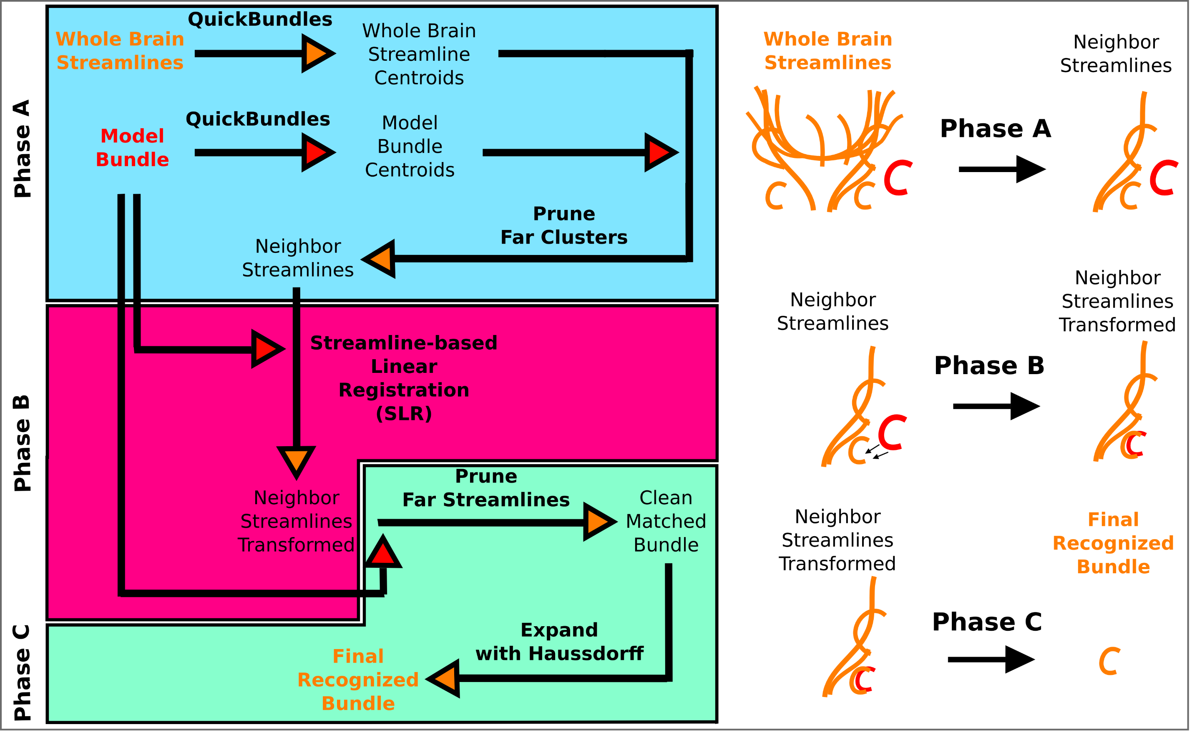
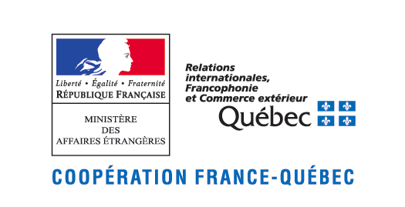


Recognition of bundles in healthy and severely diseased brains Eleftherios Garyfallidis^{1,3} , Marc-Alexandre Côté¹, Janice Hau²,
Guy Perchey², Laurent Petit², Stephen C. Cunnanne³ and Maxime Descoteaux¹
[1] Sherbrooke Connectivity Imaging Lab (SCIL), Centre d'Imagerie Moléculaire de Sherbrooke (CIMS), Centre de Recherche CHUS, Université de Sherbrooke, [2] GIN UMR5296 CNRS CEA, Université de Bordeaux, France, [3] Research Center on Aging and Department of Medicine, Université de Sherbrooke, Quebec, Canada
Introduction
Target Audience This work is addressed to all researchers who are interested in extracting anatomically relevant
bundles from diffusion MRI tractography.
Problem Extracting anatomically relevant bundles from tractography datasets is a time consuming task as these
datasets are large and noisy. Furthermore, a great amount of manual work is requested from expert neuroanatomists
using visualization tools which are currently not able to provide known bundles efficiently. This problem becomes
a true bottleneck especially in large studies delaying the analysis for many months or even years.
Proposal We propose a new automatic method which given a single model bundle from a single subject or from a bundle-specific atlas will recognize and extract the same bundle in other subjects without bias from individual shape differences. We solve this problem with precision and efficiency using a new method who is founded on streamline-based clustering using QuickBundles¹ and bundle-based registration using Streamline-Based Linear Registration^{2,3} (see Fig. 1).
Fig 1. Streamline-based Linear Registration (SLR) is robust to missing data
Method
Results
This algorithm assumes that both the model bundle and the new subject’s streamlines are in the same space registered using an initial linear registration. We recommend here to use whole brain Streamline-based Linear Registration³ between the model’s whole brain streamlines and the subject’s streamlines.
In Fig. 2 the main approach is depicted, consisting of 3 main phases:
Phase A The whole brain streamlines of the new subject and the model bundle of the reference subject are clustered using QuickBundles¹. From the centroids of the clustered results, a distance matrix, using the MDF¹ streamline distance, is used to prune the clusters that are very far from the clusters of the model bundle.
Phase B Using the neighbor streamlines which were acquired from the previous step and the model bundle and use a rigid or similarity transformation within the Streamline-based Linear Registration (SLR) algorithm. This algorithm is remarkably robust to missing data and when the registration is finished the model bundle is on top of the most similar bundle of the bundles available in the neighbor streamlines.
Phase C Finally, we can further prune to remove the rest of the streamlines which are not similar with the model bundle and/or expand with the Haussdorff distance.
Fig 3. A. Experiment in healthy populations, B. Experiment in diseased brain of grade 3 glioma tumor
The method was validated using IFOFs and UNC bundles from 60 subjects manually segmented by expert neuroanatomists. 60-70% of the streamlines in the automatically recognised bundles were exactly the same with what the experts had manually segmented without having any false positives.
n Fig. 3A, we show results for the automatic extraction of UNC in 4 subjects (S₁-S₄) in comparison to the expert manual segmentation.
In Fig. B, we see the automatic recognition of the CST in a brain with a high grade tumor⁴. In comparison, the expert neuroanatomist had to use extra information from an fMRI finger tapping experiment to strengthen his manual segmentation.
However, our new method identifies the CST in the tumor area automatically, using a bundle segmented from a healthy subject S₁, saving the expert hours of manual work.
Summary
Fig 2. Diagram of the algorithm for recognition of bundles
This method provides a quick and robust solution to the problem of identifying
corresponding bundles across healthy and severely diseased populations.
It is different from other automatic extraction techniques^{5,6} as it uses this new concept
of local streamline-based registration using SLR^{2,3} which is remarkably robust to
noisy, missing or disease-related datasets^{2,3}. Code will be available in DIPY⁷ this summer.
References
[1] Garyfallidis, QuickBundles, Frontiers in Neuroscience, (2012), [2] Garyfallidis, Direct bundle registration, ISMRM (2014), [3] Garyfallidis, Robust and efficient registration of white-matter fascicles in the space of streamlines, Neuroimage (2015), [4] Zimmer, The new science of the brain, National Geographic 36–57 (2014), [5] Guevara, Automatic fiber bundle segmentation, Neuroimage (2012), [6] Tunc, Automated tract extraction, Neuroimage (2014), [7] Garyfallidis, Dipy, a library for the analysis of diffusion MRI data, Frontiers in Neuroinformatics, (2014).
[1] M. Descoteaux, E. Angelino, S. Fitzgibbons, R. Deriche. Regularized, Fast and Robust Analytical Q-Ball Imaging, Magnetic Resonance in Medicine, Volume 58, Pages 497-510, 2007.
[2] …
Notes:
1

